Slide 1
Patient and Family Education

Slide 2
Background
Patients have a role in preventing HAIs while they are hospitalized, and an interest in strengthening hospitals’ HAI prevention efforts.
While many hospitals educate patients on general infection prevention, such as relaying the importance of hand hygiene, they do not always provide education that specifically addresses the prevention of HAIs such as CAUTIs and CLABSIs.

Slide 3
Objective
The objective of this presentation is to provide guidance about how to develop and deliver patient and family education that supports HAI prevention.

Slide 4
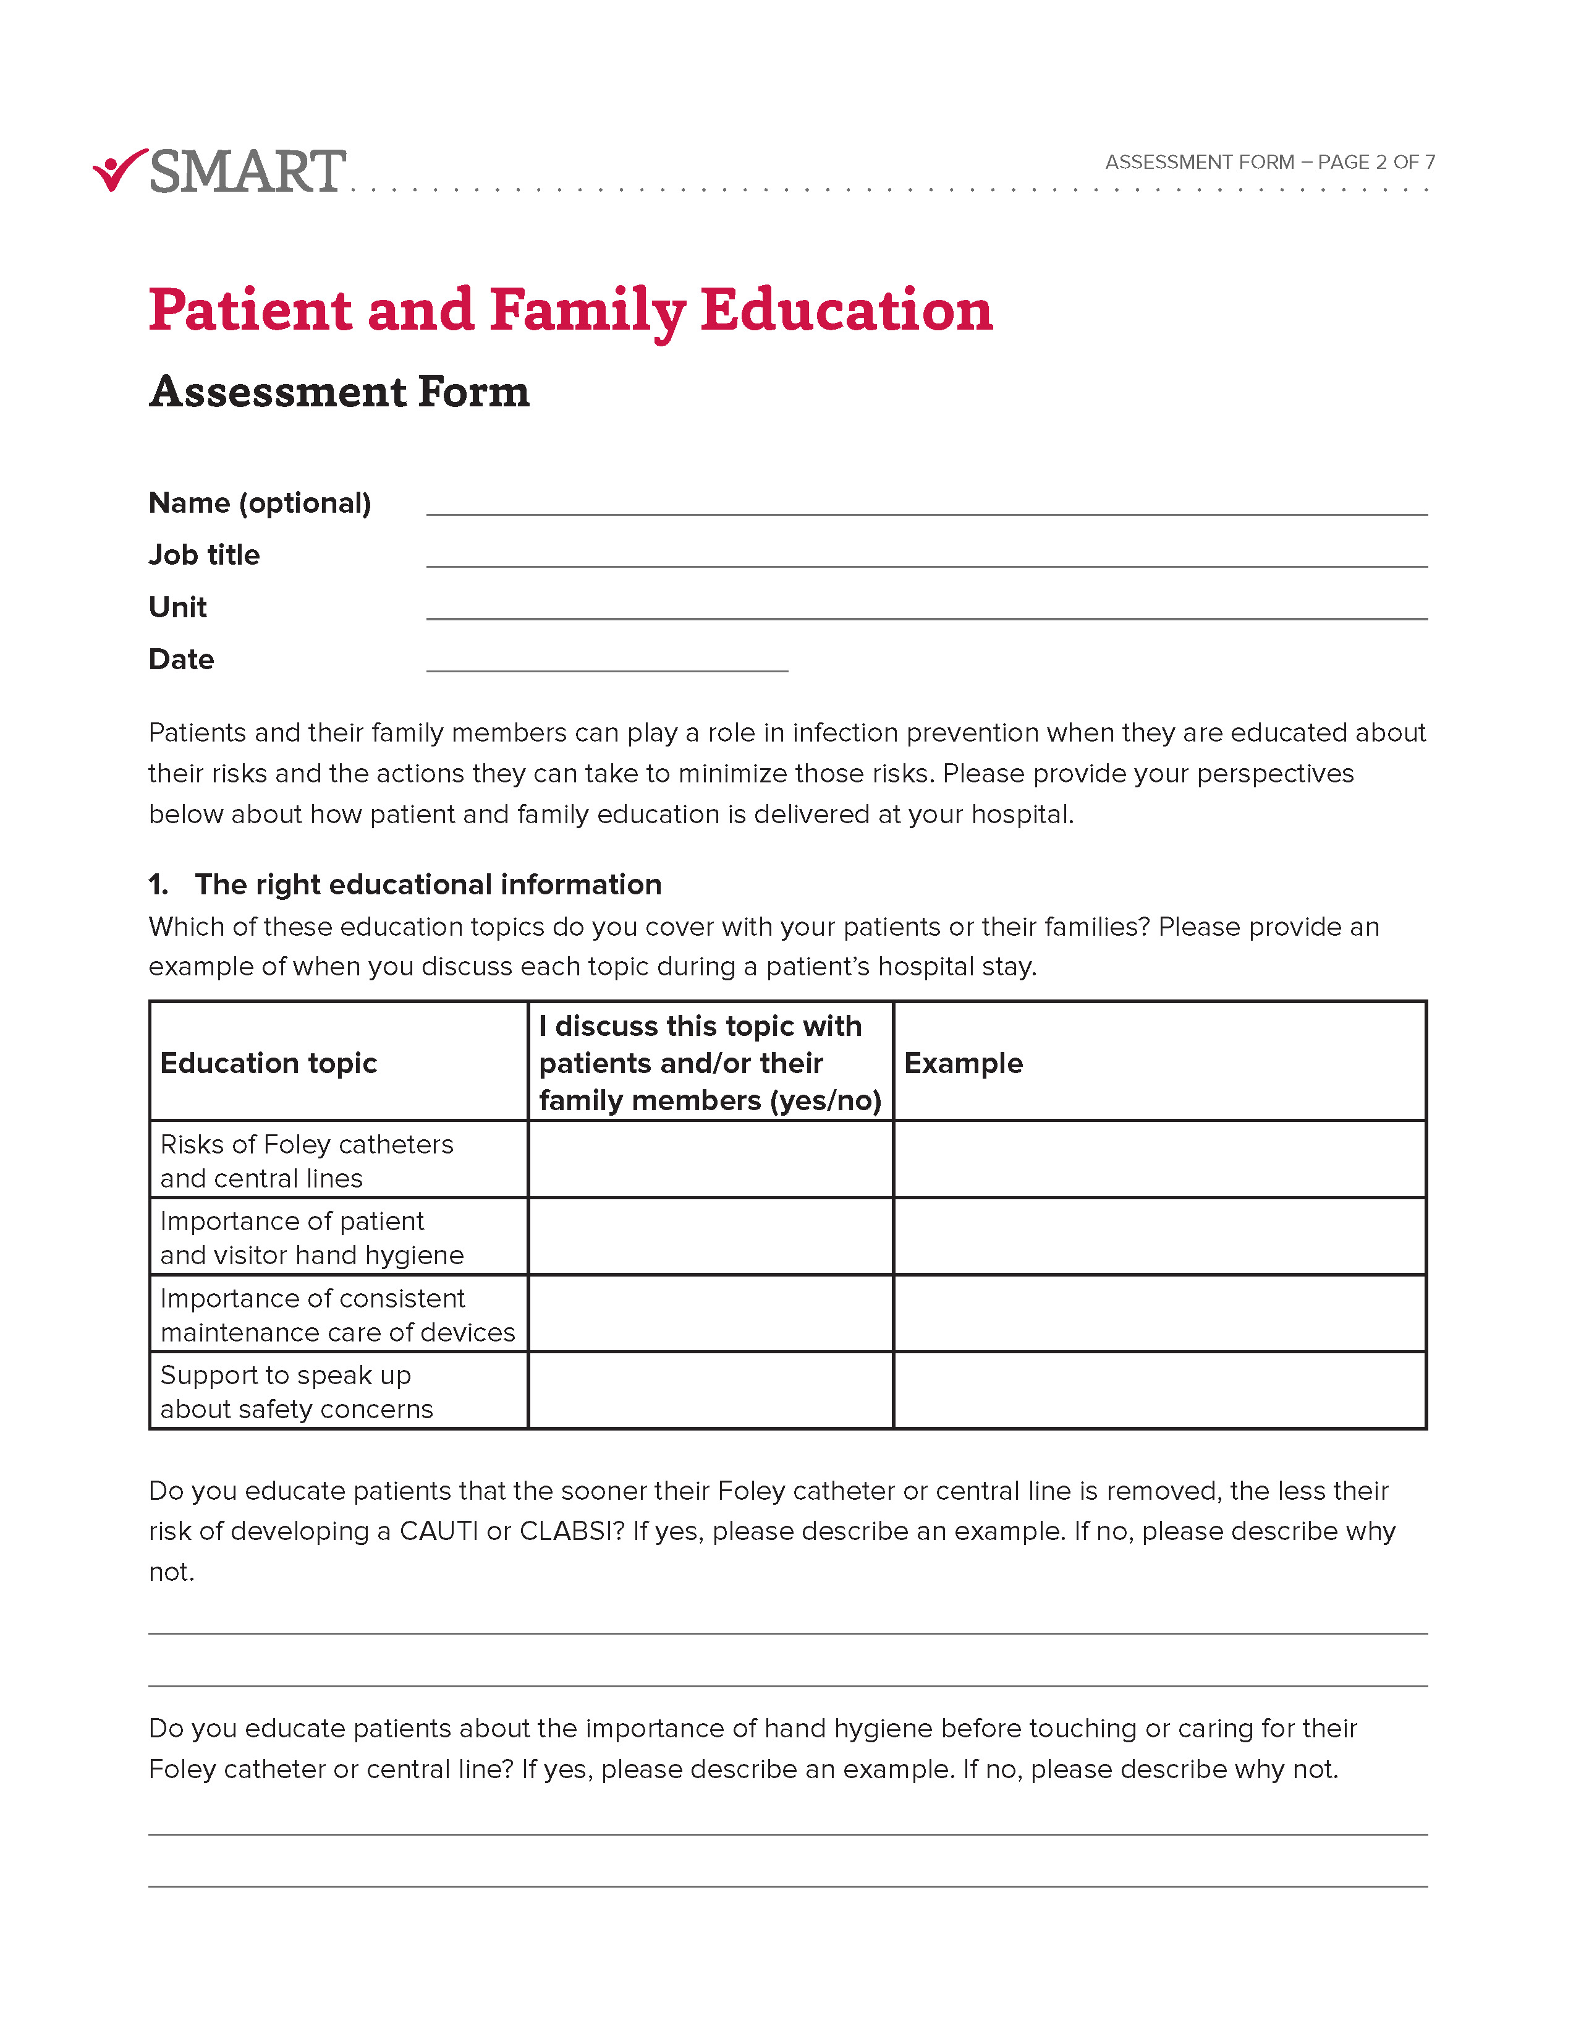
Assessment Form
Take a moment to complete the Assessment Form to help you reflect on how patient education about the prevention of CAUTIs and CLABSIs is currently used at your hospital.

Slide 5
Needs Assessment Worksheet
Throughout the presentation, please use the Needs Assessment Worksheet to reflect on ways in which patient education about the prevention of CAUTIs and CLABSIs could be improved at your hospital.

Slide 6
The Five Rights of Patient and Family Education for Infection Prevention
The right educational information
To the right person
In the right format
Through the right channel
At the right time in the patient journey

Slide 7
1: The right educational information

Slide 8
The right educational information
The right educational information includes the topics that are important for the prevention of CAUTIs and CLABSIs:
  Informing patients of the risks of Foley catheters and central lines
  Patient and visitor hand hygiene
  Consistent maintenance care of devices
  Support to speak up

Slide 9
Informing patients of the risks of Foley catheters and central lines
  Patients may be unaware that Foley catheters and central lines pose risks for infections and that removing these devices as soon they are no longer medically necessary reduces this risk.
  These three points can be shared to convey information about these risks to the patient:
  1) Having a Foley catheter or central line puts you at risk of developing an HAI ...
2) ... and an HAI will require additional medical treatment ...
3)... therefore, the sooner these devices are removed, the lower your risk for prolonged time in the hospital.

Slide 10
Patient and visitor hand hygiene
  Hospitals should consistently send the message that everyone’s hand hygiene is critical for the prevention of HAIs such as CAUTIs and CLABSIs.
  Patient and family education about hand hygiene should:
Educate patients and their visitors about the importance of hand washing before touching a Foley catheter or central line
Emphasize the need for patients to wash their hands before using Foley catheter wipes or chlorhexidine gluconate (CHG) wipes for their central line
Reiterate the need for hand hygiene for patients who leave the hospital with their device

Slide 11
Consistent maintenance care of devices
When patients don’t understand the importance of maintenance care and hygiene for infection prevention, they may be less likely to use them.
Patient education about the maintenance care of their devices should:
Educate patients about the critical role of maintenance care in infection prevention for their Foley catheter and/or central line
Involve multiple individuals in different roles (e.g., nurses, physicians, Infection Preventionists) to show a consistent message about the necessity of Foley catheter and central line care across the care team
Bring the patient into the decision-making process about when Foley catheter and central line care happen

Slide 12
Support to speak up
Patients may not realize they have the right to speak up for their safety related to their Foley catheter or central line.
Care providers should reassure patients that it is appropriate to speak up. Specifically, the care team can:
Equip patients with the words to use when their care providers, family members, or visitors are not performing appropriate hand hygiene: “Did I miss seeing you wash your hands?”
Educate patients on what to expect about the care of their devices while in the hospital and encourage them to speak up when that care is not completed as expected
Encourage patients to ask their care providers every day if they still need their Foley catheter or central line

Slide 13
Patient education resources
  Centers for Disease Control and Prevention
CLABSI Resources for Patients
https://www.cdc.gov/hai/bsi/clabsi-resources.html
CAUTI Resources for Patients
https://www.cdc.gov/hai/ca_uti/uti.html
Society for Healthcare Epidemiology of America
FAQs about CLABSIs https://www.shea-online.org/images/patients/NNL_CA-BSI.pdf
FAQs about CAUTIs - https://www.shea-online.org/images/patients/NNL_CA-UTI.pdf

Slide 14
2: To the right person

Slide 15
To the right person
  Delivering education to the right person means that both patients and family members or caregivers should be educated about how to help prevent CAUTIs and CLABSIs.
  Patients
  When educated about the risk of HAIs, and the actions they can take to reduce these risks, patients can help in efforts to prevent these infections.
  Family members or caregivers
Not all patients may be feeling well enough to advocate for themselves in the hospital or take care of themselves after discharge. In this case, educating a patient’s family member or caregiver can allow these others to act on behalf of the patient.

Slide 16
3: In the right format

Slide 17
In the right format
The right format describes the types of resources that can be used to deliver patient and family education.
Different formats for patient education include:
  Paper resources (e.g., handouts, booklets, packets)
  Posted resources (e.g., posters and digital signage)
  Electronic resources (e.g., patient portals, internet)

Slide 18
Paper resources
The value of paper resources is that patients do not need an electronic device to access them and can make notes directly on paper. The length and format of these resources varies depending on the intent. Handouts are 1-2 pages and can tell a focused story about:
  Why devices are used
  The risks that Foley catheters or central lines create for infection and their consequences for the patient
  The steps the patient, caregiver, and care team can take to keep the patient safe
  What behaviors to expect from care team members and how to speak up in support of their own care
  Discharge instructions
  Handbooks and information packets are generally longer and can serve as reference guides for patients.

Slide 19

Posted resources
Resources posted in patient rooms can be used to remind patients about device maintenance care.
  “Do you have a central line? Did you bathe with CHG?”
  “Scrub the Hub”
  Flyers posted in more public locations, such as outside patient rooms, hallways, or elevators, can inform patients and caregivers about infection prevention policies that apply to all patients.
    Posted flyers can convey importance
    of device removal
    Posters can also be used as a friendly reminder to patients that they are encouraged to speak up.
Signs, posted flyers, and electronic communication methods such as TV screens, tablet home screens, or screensavers can be used to remind patients about infection prevention practices.

Slide 20
Electronic resources
To ensure that patients who want information about caring for themselves and preventing infections have easy access to the most accurate material, organizations can provide electronic resources to patients and their families.
Patient portals
Can provide patients with access to their personal health information and educational materials during their hospital stay (through an inpatient portal) or outside of the hospital (through an outpatient portal).
Public hospital websites
Provide information for patients who do not have a patient portal as well as for family members and caregivers.

Slide 21
Guidelines for patient education resources
To create resources that are easy to understand, they should be:
Written at a 6th-grade reading level or lower
Use plain language (i.e., avoid medical jargon when possible and explain medical terms when necessary)
Use short sentences and paragraphs
Use visuals (e.g., pictures, illustrations, infographics) instead of words when possible

Slide 22
4: Through the right channel

Slide 23
Through the right channel
The right channel involves the right person to deliver the education and the right way to deliver that education.
Care providers are the ones responsible for delivering patient education.
Verbal instructions should be used to reinforce educational topics.

Slide 24
Care providers
Nurses are often the ideal providers of patient and family education due to their involvement in a patient’s care.
Involving individuals in multiple roles (e.g., nurses and physicians) in patient education is important to ensure a consistent message about infection prevention is delivered to the patient.

Slide 25
Verbal instructions
Discussions may be particularly impactful at the time of device insertion, during device maintenance, and during rounding.
Discussion about patient education topics should occur multiple times to reinforce the importance of these topics.
These discussions can remind patients that information is available for them in paper, posted, or via electronic resources.

Slide 26
5: At the right time in the patient journey

Slide 27
At the right time in the patient journey
There are many opportunities to deliver patient education throughout a patient’s hospital stay.
Providing information at multiple times is important to reinforce these education topics:
At admission
When providing care, including during device insertion and maintenance
At other times during the hospital stay
At discharge

Slide 28
At admission
Booklets or packets provided upon admission can cover general infection prevention information (e.g., hand hygiene) as well as practices specific to the prevention of CAUTIs and CLABSIs (e.g., the role of CHG baths for device maintenance).
These resources can make it clear to patients that they have a role in their safety in the hospital and that they can speak up about their concerns.
This sets the tone that the hospital culture supports patient engagement, which can encourage patients’ participation in infection prevention practices.

Slide 29
When providing care, including during device insertion and maintenance
Patient education about the risks of CAUTIs and CLABSIs should be provided at the time of device insertion.
Patients should also be informed that these devices will be removed as soon as possible to reduce the risk of developing a CAUTI or CLABSI.
When performing clinical care of Foley catheters and central lines, describe why you are performing this care and its importance for preventing infections.

Slide 30
At other times during the hospital stay
Take advantage of other opportunities to deliver patient education when patients and their caregivers are present.
Include patients in discussions about removal of devices during bedside rounding.
Bedside rounding is also an opportunity to encourage patients to speak up.

Slide 31
At discharge
Provide discharge information that includes education about what signs of infection patients should look for and how to care for their device(s) at home.
Educate caregivers if the patient cannot take care of their device themselves.
Direct patients and their caregivers to additional education resources (e.g., discharge instructions, outpatient portal, hospital websites) that they can easily access outside the hospital.

Slide 32
Delivering infection prevention education to patients
Standardizing patient education
Patient and Family Advisory Councils

Slide 33
Standardizing patient education

Slide 34
Standardization of infection prevention education for patients
Encouraging patients to participate in their care to promote safety requires effectively engaging patients in infection prevention.
Standardizing infection prevention education for patients has two primary benefits, in that it:
1) Creates a culture that establishes the patient’s role in their care
2) Empowers patients with the information they need to reduce infection risk
Two touch points for standardizing patient infection prevention education are:
1) Standardize the overall approach to patient education
2) Use the Electronic Health Record (EHR) to support the delivery of patient education

Slide 35
Standardize an approach to patient education: Patient-facing strategies
Patient-facing strategies include standardization of the education and standardization of the delivery.
Standardize the education:
Create standardized education materials
Reinforce an expectation of educating every patient
Standardize the delivery by establishing expectations about:
Who is responsible for educating the patient
When the education should occur
What resources and topics are included
How the education should be documented

Slide 36
Standardize an approach to patient education: Clinician-facing strategies
Clinician-facing strategies include normalizing the knowledge, standardizing the deployment, and reinforcing the message of patient education.
Normalize the knowledge:
All clinicians across the hospital should be aware of the strategies to engage patients in infection prevention.
Standardize the deployment:
Ensure consistent patient engagement and education strategies occur across units.
Reinforce the message:
Make staff aware of procedures to escalate patient education, when necessary.

Slide 37
Use the Electronic Health Record (EHR) to support the delivery of patient education
The EHR can automate the assignment of patient education as well as document that education was delivered. In planning to use the EHR to perform these functions, organizations can:
Develop order sets for the deployment of Foley catheters and central lines that automatically create an order/alert for patient education about the device(s).
Create alerts for patient education when infection prevention procedures are declined by the patient that escalate the need for patient education to other care providers.
Ensure care providers know it is their responsibility to document patient education in the EHR.

Slide 38
Patient and Family Advisory Councils

Slide 39
Patient and Family Advisory Councils (PFACs) in support of infection prevention
Collaborating with Patient and Family Advisory Councils (PFACs) to review educational materials and protocols can help to ensure infection prevention education is delivered in ways that patients and families find useful and impactful.
PFACs can:
Review website design
Review education materials
Help develop materials to respond to emerging issues that involve interaction between the healthcare system and patients (e.g., role of PFAC during the COVID-19 pandemic)
Help refine the process of delivering education to make it more patient-centric
Improve understanding about barriers patients may face to participating in infection prevention and elicit opinions about overcoming these challenges

Slide 40
Establishing PFACs
If your hospital does not have a PFAC, there are resources on the web to guide your organization about how to establish and implement a PFAC. Notably, when establishing PFACs, organizations should:
Involve senior leadership in the discussion about the purpose and objectives of the PFAC
Establish or leverage existing Patient Experience Departments that can oversee PFACs including recruiting and training advisors and facilitating communication with the appropriate groups across the institution
Ensure that engagement with PFACs includes providing advisors with feedback about how their work matters

Slide 41
Recruiting for PFACs
Recruiting patients and family members for Councils includes many considerations:
Recognize that recruitment is a constant effort
Advisors should be recruited who have experiences relevant to the goals of the Council
Ask unit managers to help identify and recruit potential advisors
Use posters, electronic communications, and personal communications to make patients and family members aware of PFACs and encourage them to join
Establish diversity in the Council by considering the demographics of members including race, ethnicity, gender, age, etc.
Provide appropriate accommodations to encourage Council Member participation

Slide 42
Resources for the creation and use of PFACs
Agency for Healthcare Research and Quality (AHRQ):
https://www.ahrq.gov/patient-safety/patients-families/engagingfamilies/strategy1/index.html
Institute for Patient and Family Centered Care (IPFCC): https://www.ipfcc.org/
Beryl Institute: https://www.theberylinstitute.org/page/PFAResources
Patient-Centered Outcomes Research Institute (PCORI):
https://www.pcori.org/research-results/2015/building-knowledge-how-patient-family-advisory-councils-pfacs-engage-patient
America’s Essential Hospitals:
https://essentialhospitals.org/quality/a-blueprint-for-patient-advisory-boards/

Slide 43
Summary
Patients can play a role in the prevention of CAUTIs and CLABSIs when they are educated about their risks and what they can do to reduce those risks.
Consider the Five Rights when developing strategies for patient education about infection prevention:
  The right educational information
  To the right person
  In the right format
  Through the right channel
  At the right time in the patient journey
Standardize infection prevention education for patients
Involve PFACs to support patient education about infection prevention

Slide 44
Using the worksheet
Please complete the Needs Assessment Worksheet to reflect on ways in which patient education about the prevention of CAUTIs and CLABSIs could be improved at your hospital.
Use the responses in the Needs Assessment Worksheet to guide next steps your hospital can take to improve patient education.

Slide 45
The key takeaway is ...
Educating patients and families early and often about HAI risks and prevention measures makes them valuable partners in their care.

Slide 46
Concluding information
The research and development of this toolkit were funded by the Agency for Healthcare Research and Quality [Grant# R01HS024958].
If you would like further information about this study, or would like to participate in future research studies, please contact the SMART Principal Investigator, Dr. Ann McAlearney, at ann.mcalearney@osumc.edu.

